Slide 1
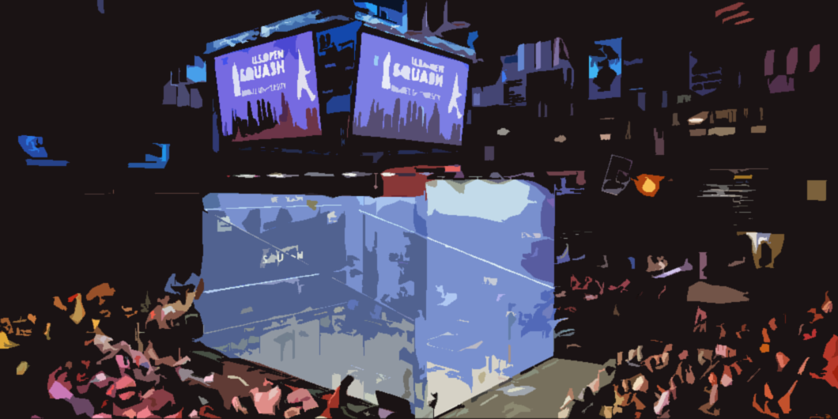


A Master’s Thesis on
Detection and Tracking of a Fast Moving Object in Squash using a Low-Cost Approach
Saumil Sachdeva
16
07
2019
Committee
Dr. ir. J.S.S.M. Wong Dr. Ir. D. Blom
Dr. ir. A.J. van Genderen Dr. A. Prins
Dr. M. Zuniga
MSc Embedded Systems
Notes:
Ruimte voor notities…..

Slide 2


Agenda
Chapters of the presentation
1
Motivation AND Objectives
2
Process Overview and related work
3
Pre Processing
Agenda
4
Ball Detection
5
Ball Tracking
6
Optimizations on the processor
7
Conclusion, discussion and future work

Slide 3

1
Motivation And
Objectives

Slide 4
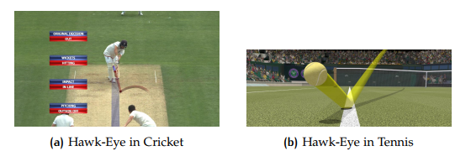
Motivation And Objectives
Motivation
Squash is termed as the healthiest sport in the world, with 20 million active players ^{[1]} -> Need for a dedicated system!
Squash ball moves at a really high-speed, is small-sized and suffers from constant occlusion with the players -> Research Challenge!
Ball-Tracking in sports has always been done utilizing high computation power with multiple cameras, but such an approach is feasible only to a few mainstream sports such as Tennis and Cricket -> Research Challenge!
[1] Forbes (2003). Squash: Number one Healthiest Sport to play. https://www.forbes. com/2003/09/30/cx_ns_1001featslide.html?thisSpeed=20000#2f0602e35ba6. Accessed: 2019-03-25
Notes:
With the betterment in tech ….
Primary objective is to track the ball
These techniques already being used but none for squash
Provides interesting scenario
The techniques that are used currently are high cost

Slide 5
Motivation And Objectives
Problem Statement
Detect and Track a Squash ball using a single camera view and implement the system on a low-cost platform
Notes:
- RPI

Slide 6
Motivation And Objectives
Objectives
Study the ball detection methods present in the literature and implement the methods that are suitable for the peculiar scenario of Squash. Measure their performance by calculating the accuracy of the system.
Study the ball tracking methods present in the literature and implement the method(s) that fit the criteria of the project (fast, accurate, memory efficient). Measure their performance by comparing the ball-trajectories with the detections.
Analyze the optimization steps needed for carrying out the process on a Raspberry Pi and measure the performance using a timing analysis. Evaluate whether the system can function under real-time constraints.
Notes:
Detect in each frame
Combine detections solving problems
Implement on rpi and evaluate whether it is real time or not

Slide 7
2
Process Overview and related work

Slide 8
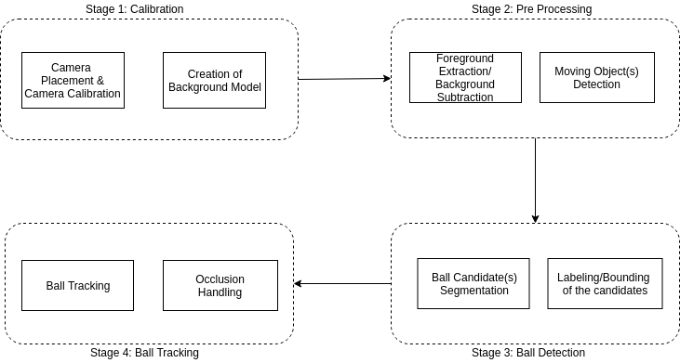
Process Overview And Related Work
Process Overview
Notes:
Calibration: place the camera, calculate thresholds and boundary values using intrinsic and extrinsic. NOT DONE
Pre-processing: separate moving from non-moving
Detection: out of the moving which is the ball
Tracking: build a 2D final trajectory

Slide 9
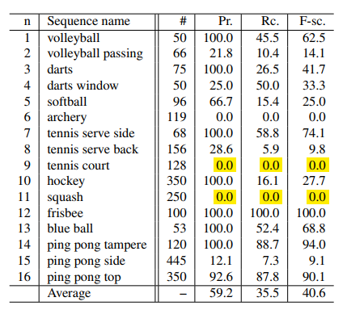
Process Overview And Related Work
Related Work
The only previous work done for Squash ^{[1]} reports insignificant results
Tennis as a sport bears a lot of resemblance to Squash, which can be used as a reference in the literature
[1] Rozumnyi, D., Kotera, J., Sroubek, F., Novotny, L., and Matas, J. ( ` 2017). The world of fast moving objects. In CVPR, pages 4838–4846
Notes:
Not much prior work done for squash. The only work reports 0% detection accuracy because….
Therefore, tennis can be used as a reference to perform ball tracking in squash

Slide 10
Process Overview And Related Work
Related Work and Hypotheses
Dataset-> Single Camera, Multiple Cameras, Broadcast TV Videos
Foreground Extraction-> Background Modelling, Frame Differencing
Ball Detection-> Color, Shape, Size, Region, Velocity
Ball Tracking-> Kalman Filter, Particle Filter, Trajectory-based approach, Data-association
Platforms-> High-computation platforms in every work
Notes:
Dataset: 3 common strategies, BTV is easiest and provides the kind of single camera view that is needed
FE: frame diff faster
Det: Color shape popular but won’t work
Tracking: KF most popular
Platforms: High computation platforms

Slide 11
3
Pre Processing

Slide 12
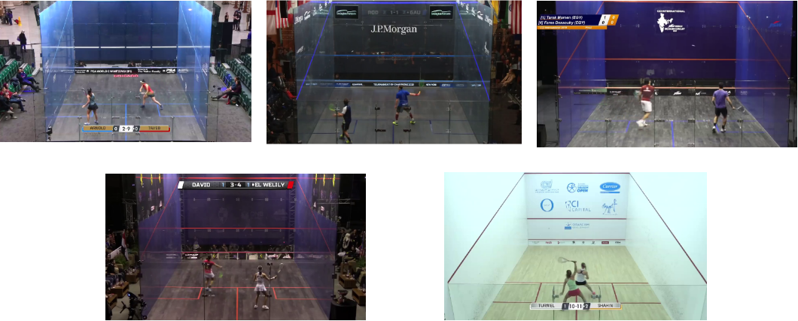
Pre Processing
Dataset
10 shot rallies from 5 different broadcast matches
Total 2500 Image Frames
25 FPS
720p Resolution
Notes:
- Unregularized
- Male female, different arenas, white ball, black ball
- Dark colored courts and white ball in professional

Slide 13
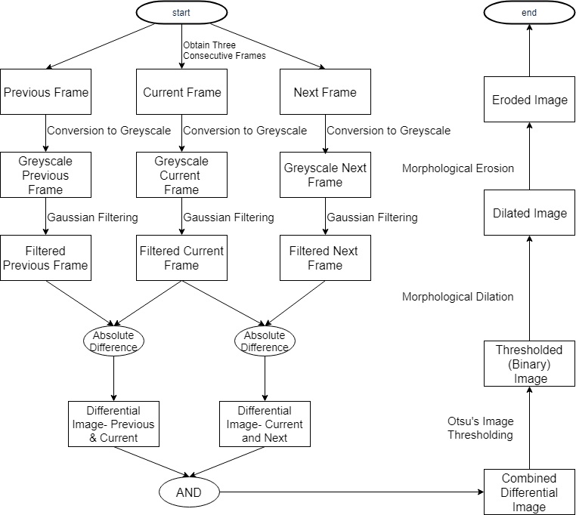
Pre Processing
Overview

Slide 14
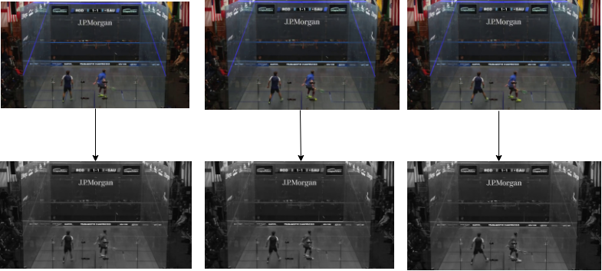
Pre Processing
FOREGROUND EXTRACTION
Conversion to grayscale
Computer Vision, like Human vision, depends on contrasts and patterns
Information of an image is captured more in the luminance component (Intensity) compared to the chrominance component (Color)
Greyscale image is easier to process computationally
Notes:
2 reasons: to detect motion instead of color, contrast and change in intensity is needed which can be captured in a greyscale variant
1 8 bit component

Slide 15
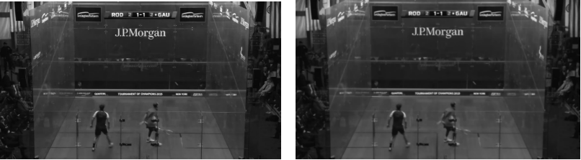
Pre Processing
FOREGROUND EXTRACTION
Gaussian Filtering
Gaussian Filter is a Linear Filter -> Fast!
Doesn’t preserve edges like the Median Filter
The property of Separable Convolution means it is Memory Efficient!
Notes:
Smoothens the image and removes noise
Addition and multiplication faster than sorting

Slide 16
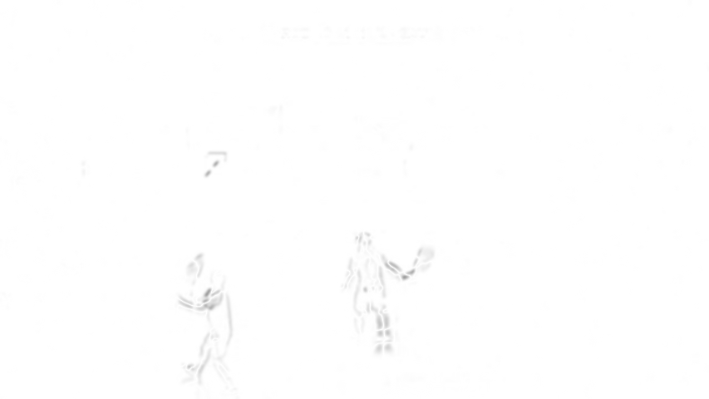
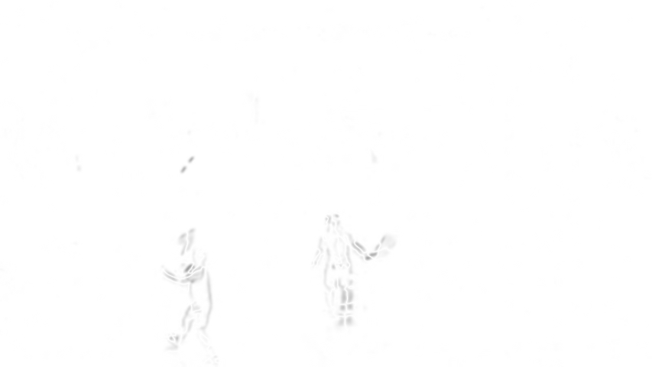
Pre Processing
FOREGROUND EXTRACTION
Frame Differencing
Two Diﬀerence images created from 3 consecutive image frames
Pros-> Faster than creating and working with a background model
Cons -> Not as robust to noise and camera movement
Notes:
Captures motion from one frame to the other
As can be seen in the figure outline of the player and the movement of the ball

Slide 17
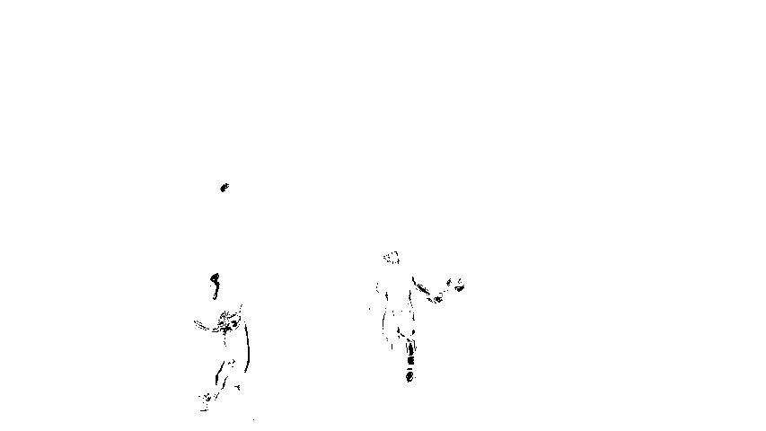
Pre Processing
Boolean Combination and Thresholding
Greyscale combination image generated by performing AND operation which has pixels as shades of grey
Binary image after thresholding has foreground pixels as ‘1’ and background as ‘0’
dst(x,y) = { 0 if src(x,y) >threshold 1 otherwise }
Otsu’s Binarization used for Thresholding as more background pixels than foreground pixels
Notes:
Only 2 classes of pixels, one in foreground black and one in background white
Otsu used when 2 separate classes of pixels
Player not connected
-Simple when a global thresh, dynamic when things change rapidly
- Otsu for bimodal image

Slide 18
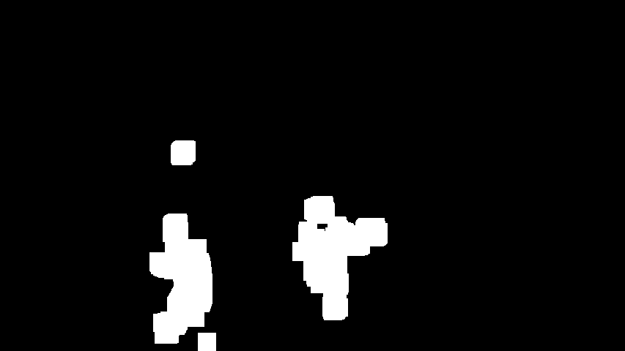
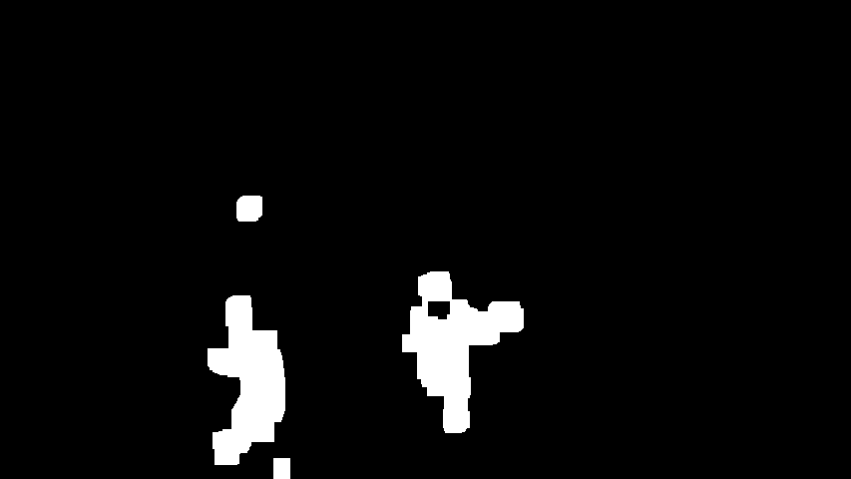
Pre Processing
Morphological Operations
Erosion Reduces the size of the dilated image and filters out small noises
Works by setting a pixel value to ‘0’ if any neighboring pixel value is ‘0’
Dilation ‘’Amplifes’’ the Foreground
Works by setting a pixel value to ‘1’ if any neighboring pixel value is ‘1’
Notes:
Joins the player
Reduces the size

Slide 19
4
Ball Detection

Slide 20
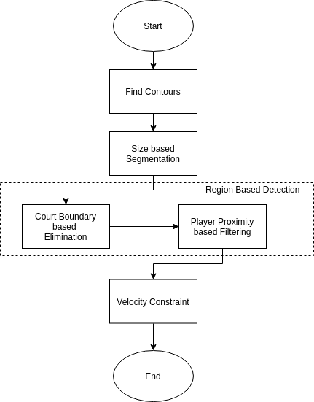
Ball Detection
Overview

Slide 21
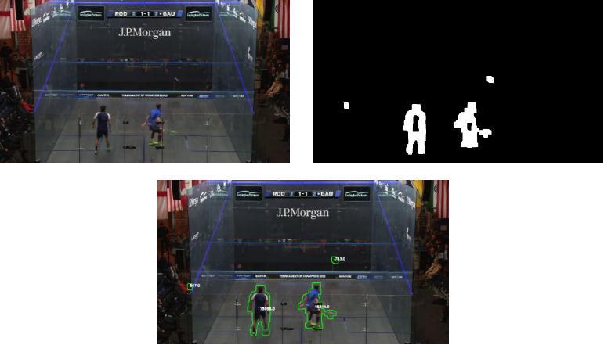
Ball Detection
Contouring
Contours are created using the border following algorithm by Suzuki et al ^{[1]}
Creates hierarchical borders of an object
Fast Execution time
Contour Approximation means it returns only few points on the contour → Memory Efficient
[1] Suzuki, S. et al. (1985). Topological structural analysis of digitized binary images by border following . Computer vision, graphics, and image processing, 30(1):32–46
Notes:
The algorithm results both inner and outer contours
With contour approx. only few points on the contour are selected

Slide 22
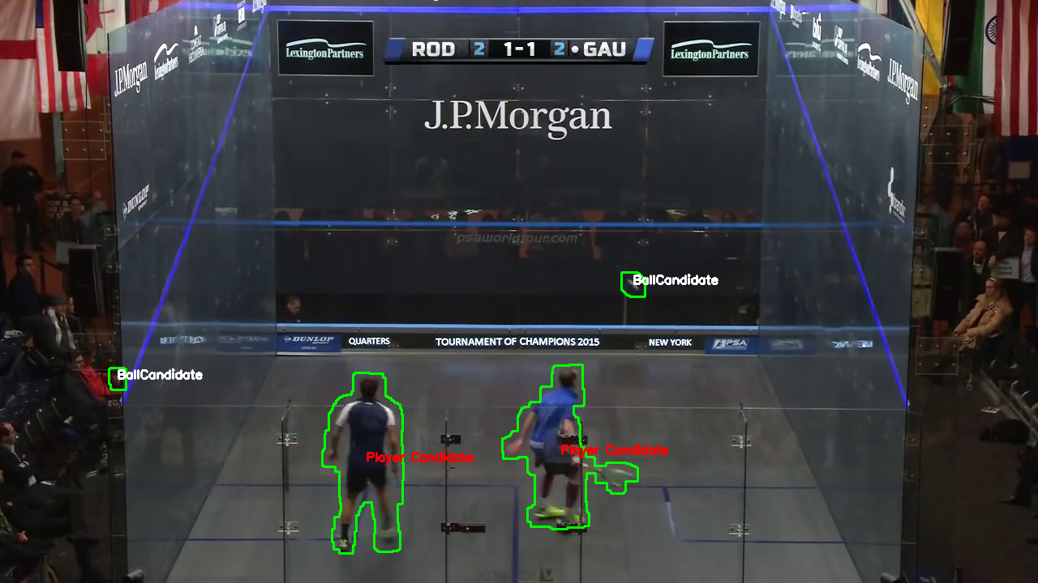
Ball Detection
Size Based Segmentation
Size of the objects calculated using the Zeroth Image moment: M₀₀=∑_{x}∑_{y}x⁰y⁰I(x,y) => M₀₀=∑_{x}∑_{y}I(x, y)
Size Thresholds calculated using a statistical analysis of the two data-sets
Notes:
Size of objects calculated
Then segmented in 3 categories
ballcand, playercand, incompletePlayercand

Slide 23
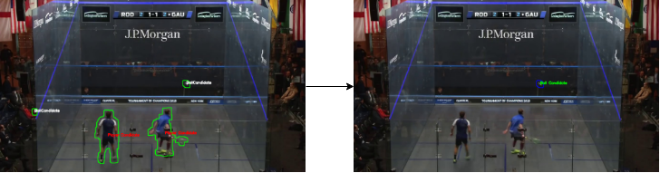
Ball Detection
Region Based Segmentation
Court Boundary based Elimination
Only the candidates inside the court-region are selected, others are discarded
Notes:
- Values precomputed, calibration could do this

Slide 24
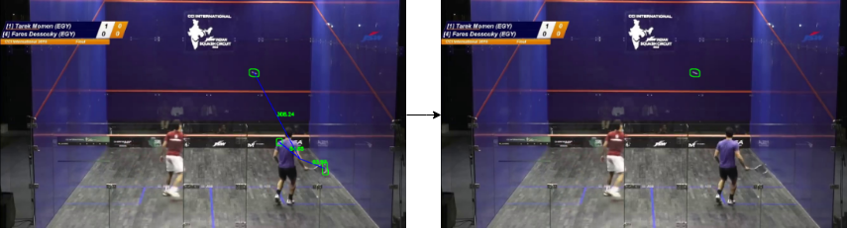
Ball Detection
Region Based Segmentation
Player Proximity based Filtering
Candidates that are extremely close to a player are generally the ﬂailing body part of the player segmented incorrectly during pre processing
Proximity Threshold calculated using a statistical analysis of the data-sets
Notes:
Candidates in extreme vicinity of the player are the part of the player that has moved too fast and filtered

Slide 25
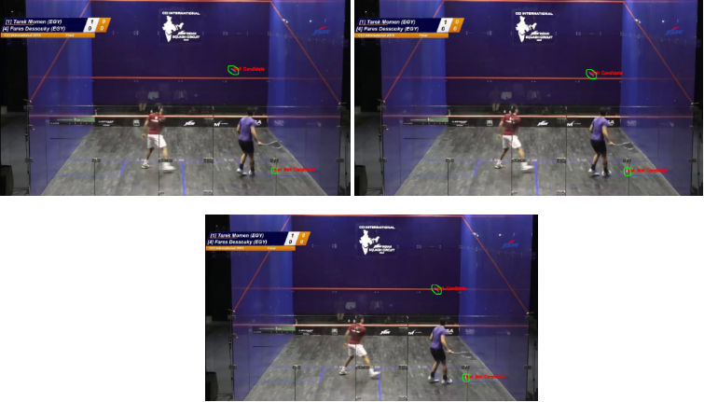
Ball Detection
Velocity Constraint
Candidates in current frame are compared with the candidates in the previous frame to observe movement from previous to current frame
If the motion is within a velocity range, the candidate is accepted as a ball candidate else filtered
Cons → If a single wrong candidate detected in the previous frame, then the correct candidate in current frame is lost as well => False Negative!
Notes:
Cand from current compared to previous. If any cand doesn’t fit the velocity range of squash ball it is filtered out
One drawback, can be fixed in tracking stage

Slide 26
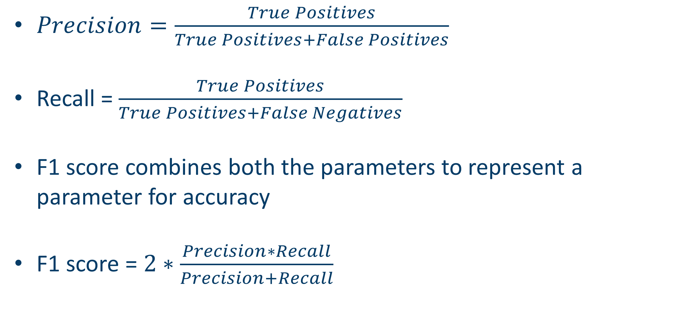
Ball Detection
Results (Meterics)
$Precision=\frac{True Positives}{True Positives+False Positives}$
Recall = $\frac{True Positives}{True Positives+False Negatives}$
F1 score combines both the parameters to represent a parameter for accuracy
F1 score = $2∗\frac{Precision∗Recall}{Precision+Recall}$
Notes:
Recall signifies the ability of the algorithm to classify relevant cand
Precision tells out of the relevant how many are actually relevant

Slide 27
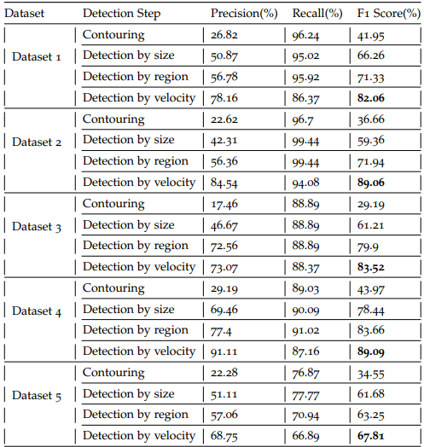
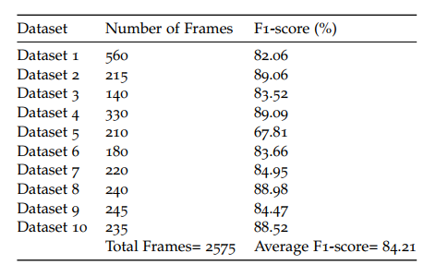
Ball Detection
Results (contd)
Notes:
Average 85
Precision increases with every detection step
Dataset5 bad since detecting semi transparent over white background very difficult, this is one of the prime reasons professional played in dark colored glass

Slide 28
5
Ball Tracking

Slide 29
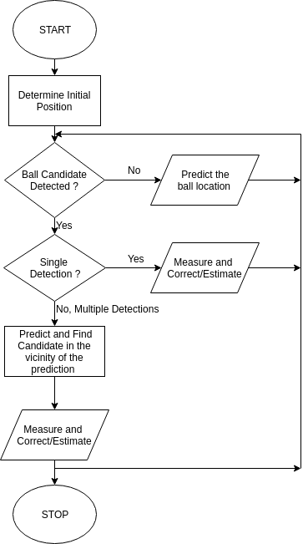
Ball Tracking
Process
3 Cases in each image frame:
Single Detection
Multiple Detections
No Detections

Slide 30
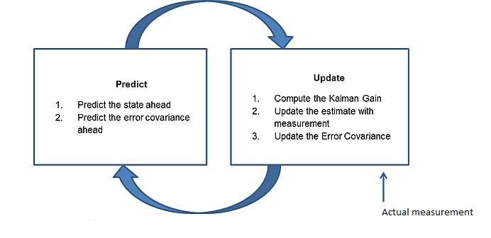
Ball Tracking
Using a Kalman Filter
Preferred approach from the literature
Works well in linear scenarios but performs poorly during long instances of occlusion and during non-linear scenarios
Fast and Light on memory
Image taken from: https://towardsdatascience.com/an-intro-to-kalman-filters-for-autonomous-vehicles-f43dd2e2004b
Notes:
Suggested approach from the literature since fast, light on memory
The position and velocity in x y dir used as state variable and kinematic equations with constant vel as motion model
Drawback no detections for long sequence, non linear when trajectory suddenly changes

Slide 31
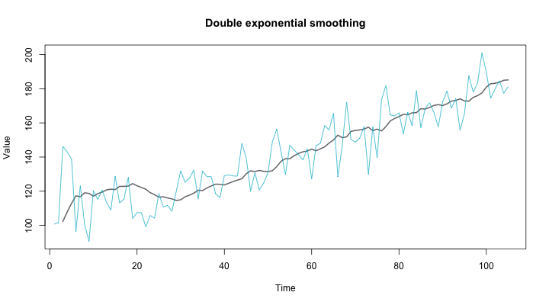
Ball Tracking
Using Double-Exponential Smoothing
Forecasting technique which assigns exponentially decreasing weights to the observations over time
Double Exponential Smoothing takes the “trend” of data in account as well
Level (obs): s_{t}=αx_{t}+(1 - α)(s_{t-1} + b_{t-1}) Trend (slope): b_{t}=β(s_{t} - s_{t-1}) + (1-β) b_{t-1}
α, β are smoothing constants
Future Prediction: F_{t+m}= s_{t} + mb_{t}
Image taken from: https://www.vividcortex.com/blog/exponential-smoothing-for-time-series-forecasting
Notes:
In it expo dec weights to observations, therefore more weights can be given to recent obser
Keeps trend of the data in account

Slide 32
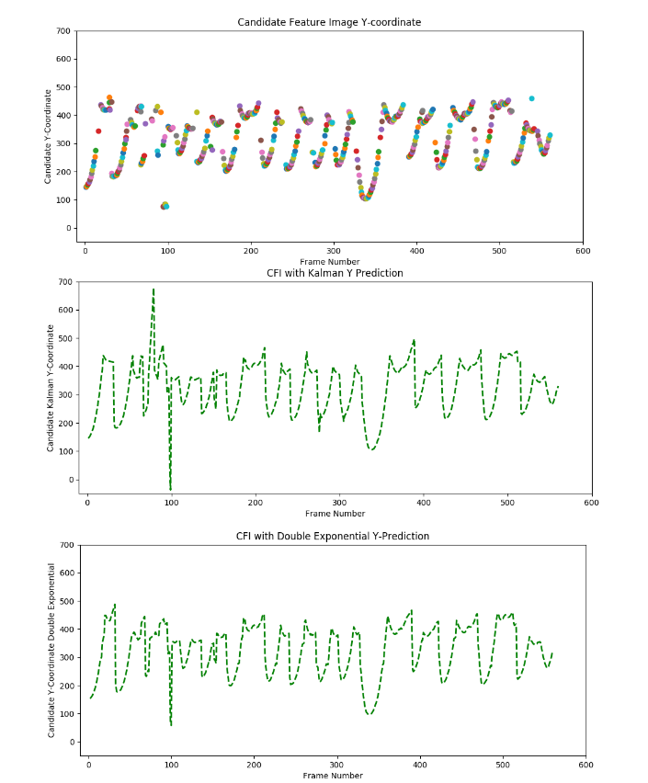
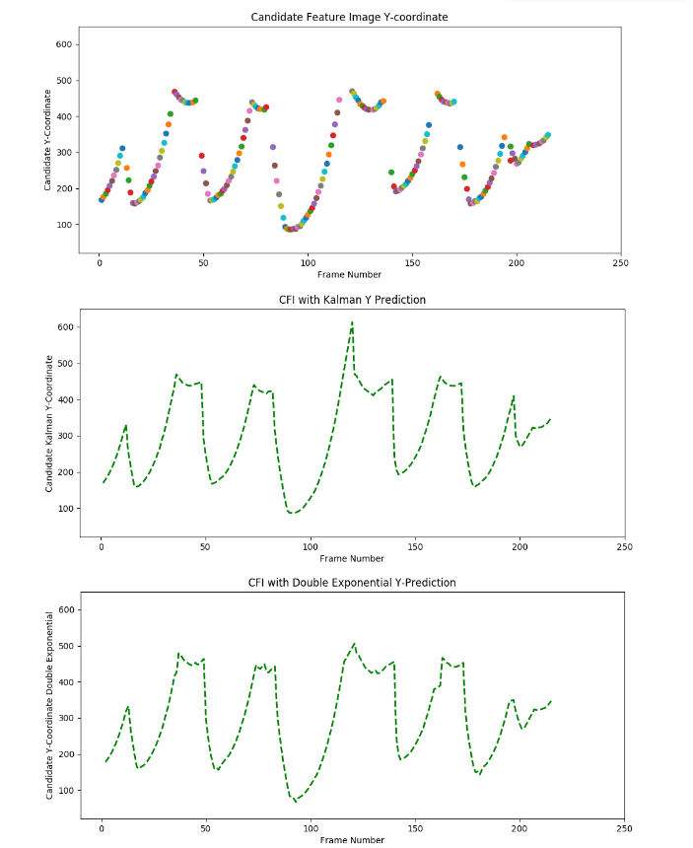
Ball Tracking
Results
<<- Dataset 1
Dataset 2 ->>
Exponential Smoothing better in adjusting when ball-direction changes
It is also “smoother” and has less number of peaks
Notes:
Y coordinate vs frame number
Top detections
Middle Kalman
Bottom exp
Double exp adjusts quickly when change of direction due to more weights to recent obs
Also more smoother as it keeps trend of data in acc

Slide 33
6
Processor Optimizations

Slide 34
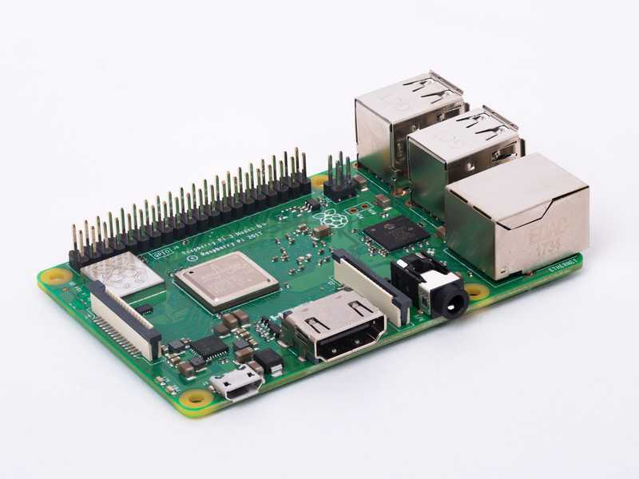
Optimizations on the Processor
Implementation Platform
Raspberry-Pi 3B+
Arm Cortex A-53 -> 64-bit 1.4 GHz
1 GB RAM
Python3 with OpenCV library

Slide 35
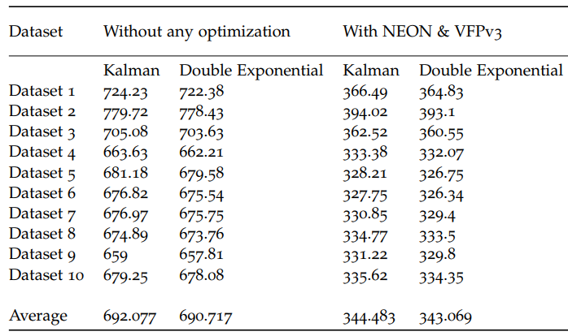
Optimizations on the Processor
Arm NEON and VFPv3
Arm NEON -> Single Instruction Multiple Data ISA
VFPv3-> Vector Floating Point ISA, support for half, single, double precision values
OpenCV functions uses these optimizations in its functions
49% reduction in execution time with these optimizations
Notes:
Arm has built the NEON arch extension inside the Arm v8 arch which focusses on video processing and signal processing applications
Whereas VFP is the floating point hardware accelerator by Am to speed up the floating point calculations
Cv func implemented in the Opencv library when enabled can use these optimizations

Slide 36
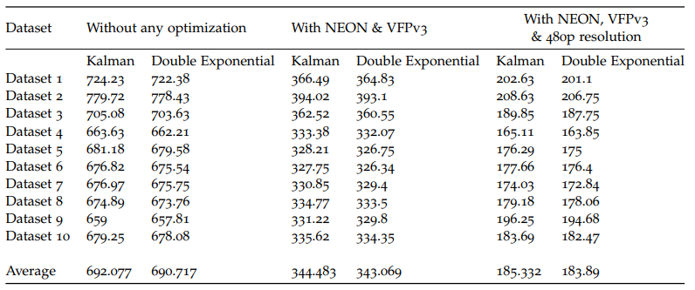
Optimizations on the Processor
Video Resolution
Image Resolution modified from 720x1280 to 480x854
Further 45% reduction in execution time
No effect on the accuracy of the detection algorithm
Notes:
From 720p to 480p
No effect on the detection and further reduction of 45%

Slide 37
Optimizations on the Processor
Multiprocessing-> Hardware Limitation!
Raspberry Pi has a quad-core processor
Attempt to parallelize the pre-processing stage is unsuccessful due to the limited memory (1 Gb) of the Pi
Python doesn’t support multithreading due to its Global Interpreter lock
Notes:
Cortex a53 is a quadcore proc so theoritally multiprocessing can be applied to speed up the fe stage where 3 images are taken
But practically it was not possible due to the 1gb memory of pi

Slide 38
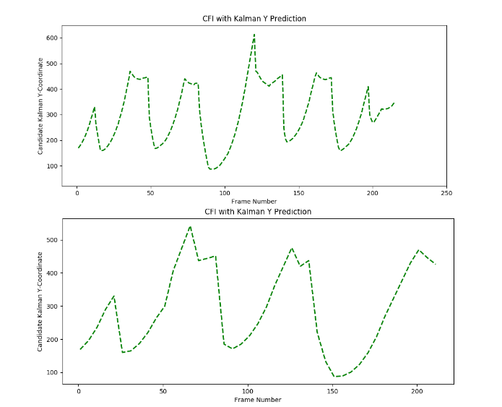
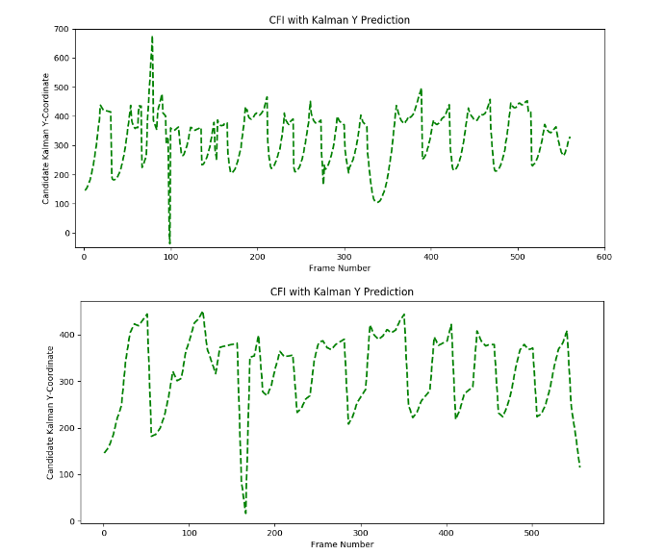
Optimizations on the Processor
Frame-Rate Adjustment-> Not Viable!
Frame-rate has to be adjusted to 5 FPS for the processing to be real-time
5FPS leads to a loss of true-information as it suffers from a lack of ball-detection information
Not suitable
Notes:
The execution times after previous optimiz come to be around 200 msec per fame, for real time 5fps should be used
The results show due to lack of ball detection info the tracjectories don’t represent true ball information

Slide 39
6
Conclusion, Discussion and Future Work

Slide 40
Conclusion, Discussion and Future Work
Conclusion
Ball Detection- Average accuracy (F1 score) of 85% using properties such as size, region and velocity
Ball Tracking- Holt’s Double exponential smoothing results in better and smoother trajectories than the Kalman Filter
Not real-time but optimized to run efficiently on the Arm Cortex A-53 by reducing the execution times by 70%
Applications such as real-time line calling not feasible but the system can be used for game-analysis and shot analysis

Slide 41
Conclusion, Discussion and Future Work
Main Contributions
One of the first works that has it primary focus on Squash, this caters to the need of 20 million active Squash players
Ball detected with 85 % accuracy using its size, velocity and region -> in contrast to the literature where colour and shape based segmentation are the most popular methods
Application of a novel method to ball-tracking -> Double exponential smoothing is a simple yet powerful method for prediction/tracking
One of the first works that uses and promotes low-cost methods to perform ball-tracking -> in contrast to the current state-of-the-art
Notes:
One of the first works with the primary focus on ball tracking in squash. This is a first step in building a tracking system for 20 mil players
Doesn’t utilize the popular methods in the literature yet still result in good results
Application of a novel technique to ball tracking.smoothing is used in financial applications but this work shows this simple yet powerful technique can be used in ball tracking as well
One of the primary works which performs the process on low cost. With the cost of processsors decreasing, this supports the idea of building portable low cost solutions

Slide 42
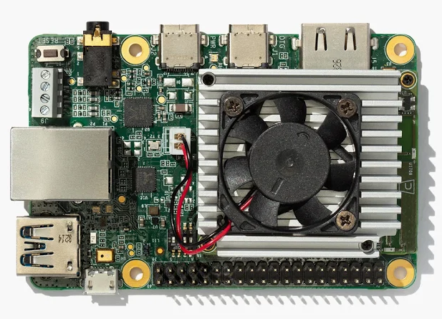
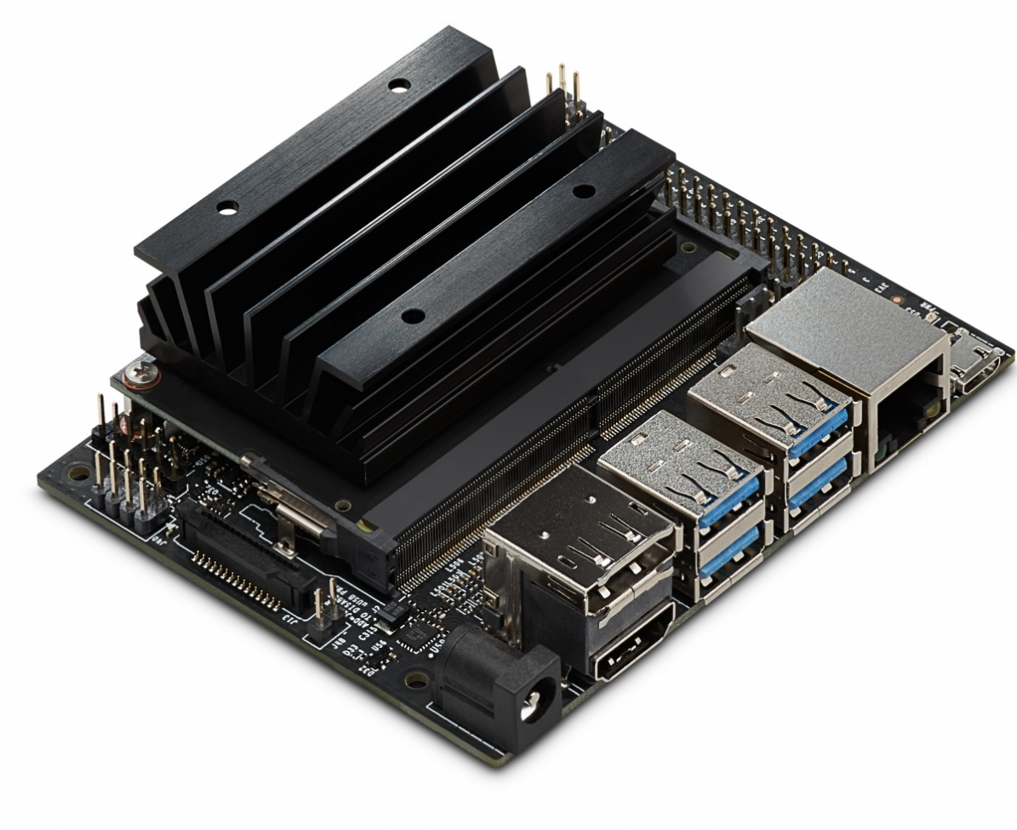
Conclusion, Discussion and Future Work
Future Work
Deep Learning with Computer Vision-> using Google Coral ^{[1]} or NVIDIA Jetson Nano ^{[2]} boards launched this year
Build a complete unit housing the processor and camera together -> for Calibration stage and control over the frame-rate of the camera
[1] Google (2019). Coral. https://coral.withgoogle.com/. Accessed: 2019-06-12. [2] NVIDIA (2019). Jetson Nano. https://developer.nvidia.com/embedded/ jetson-nano-developer-kit. Accessed: 2019-06-12.
Notes:
The detections can be improves by using deep learning
As an extension of this project, both can be housed together as one unit which gives control over the camera and calibration stage can be built as well

Slide 43
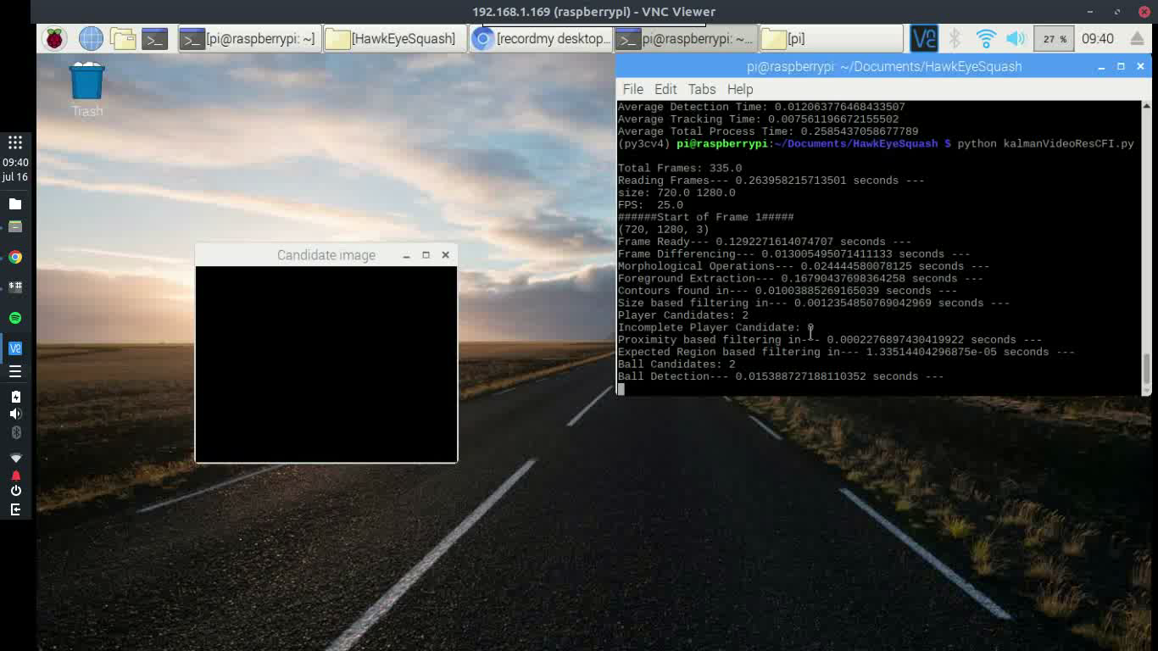
Demo

Slide 44
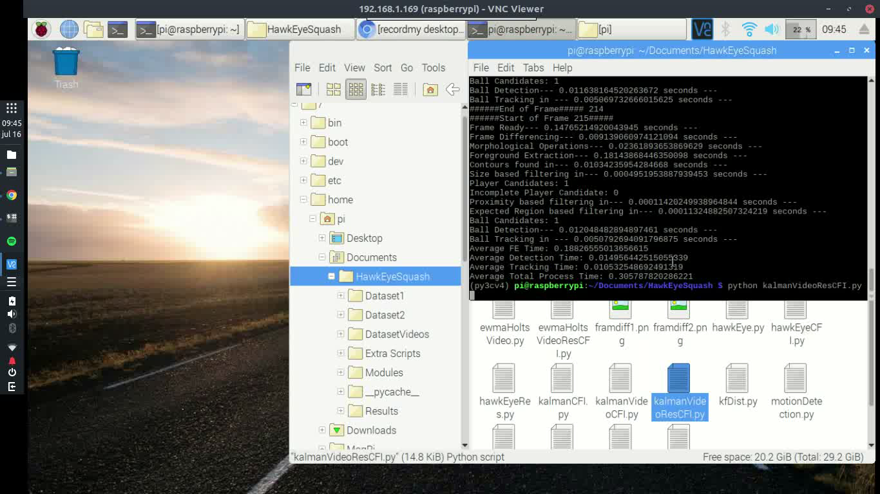
Demo

Slide 45
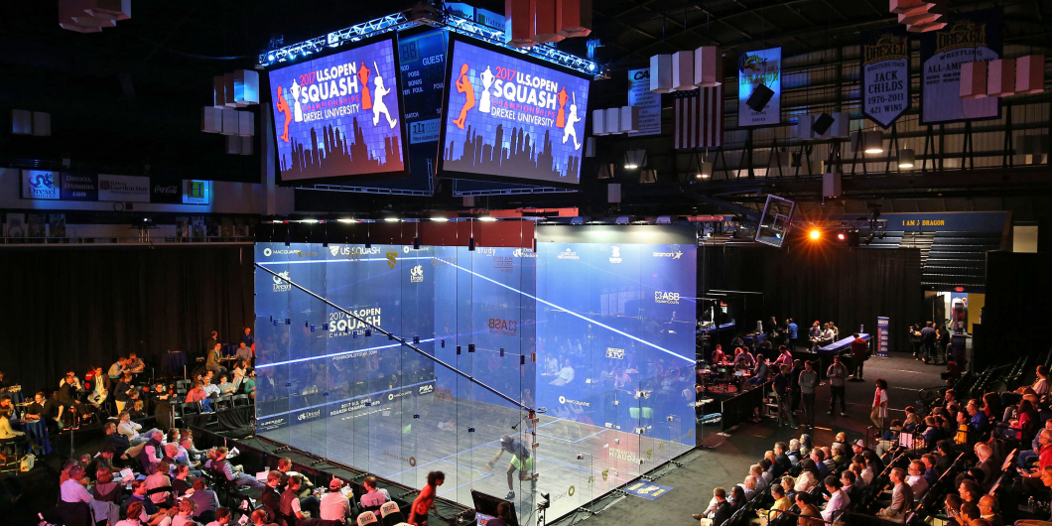
Thank you for your attention !
Questions?
Saumil Sachdeva
16
07
2019
MSc Embedded Systems

